Slide 1
Hyperband on Spark

Slide 2
Agenda
Introduction to Spark Model Selection
Hyperband on Spark
Example: Hyperband Vs Grid Search

Slide 3
Introduction to Spark Model Selection

Slide 4
Spark MLlib Model selection (1)
Train-Validation Split
Cross-Validation
Creates a single (training, test) dataset pair and evaluates each combination of parameters once
finally fits the Estimator using the best Param Map and the entire dataset.
Splitting the dataset into a set of folds which are used as separate training and test datasets
To evaluate a particular Param Map, it computes the average evaluation metric for all the models generated for each fold.

Slide 5
MLlib Model selection (2)
Cross-Validation
Training | Test
Result 1
Result 2
AVG
Result
Training | Test
Param A | Param B
A1 | B1
A1 | B2
A2 | B1
A2 | B2
Training | Test
Result 3
Train-Validation Split
Training | Test
Result

Slide 6
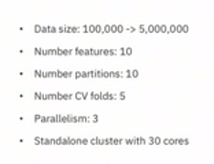
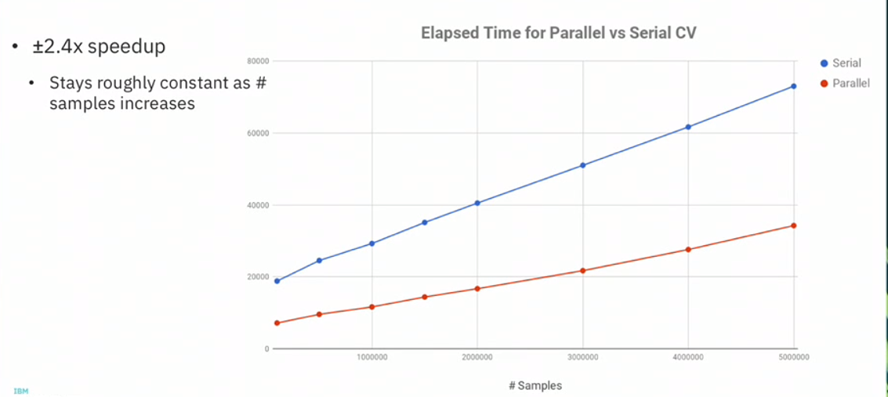
Model Parallelism (Spark ML Tuning)
Enabling model parallelism in Spark cross-validation - allowing for more than one model to be trained and evaluated at the same time
parallelism parameter controls the number of jobs sent to the Spark scheduler which can help to make better use of available cluster resources
The best approach is to shoot for having a few jobs in the queue to make sure all available resources are utilized, without overdoing it.

Slide 7
Model Parallelism (Spark ML Tuning)
Executer 1
Data
Partition 1
Task (Model 1)
Model 2
Model 1
Executer 2
Data
Partition 2
Task (Model 1)
Executer 3
Executer 4

Slide 8
Model Parallelism (Spark ML Tuning)
Executer 1
Data
Partition 1
Task (Model 1)
Model 1
Executer 2
Data
Partition 2
Task (Model 1)
Executer 3
Data
Partition 1
Task (Model 2)
Model 2
Executer 4
Data
Partition 2
Task (Model 2)

Slide 9
Bayesian Optimization & Hyperband on Spark

Slide 10
BOHB - Bayesian Optimization & Hyperband
BOHB .
Bayesian Optimization
(Tree Parzen Structure)
Hyperband
BOHB combine the benefits of both Bayesian optimization and bandit based methods in order to achieve the best of both worlds

Slide 11
Successive Halving
The algorithm allocates exponentially more resources to more promising configurations.
Uniformly allocate a budget to a set of hyperparameter configurations
Evaluate the performance of all configurations
Throw out the worst half
Repeat until one configuration remains
However, for a fixed B, it is not clear a priori whether we should
(large n) with a small Resources or
(small n) with longer Resources.

Slide 12



n, number of configurations (Hyper parameters values)
B, Finite Uniform Budget
Iteration 1, n = 27
Iteration 2, n = 9
Iteration 3, n = 1

Slide 13


D-Smart ML Overview
Extract Metadata
Select Based Algorithm
(based on the KB)
Get Best Hyperparameters
(Using Hyperband)
1
2
3
Dataset
Best Model

Slide 14
D-Smart Parameters
Parameter | Description | Data Type | Default
eta | an input that controls the proportion of configurations discarded in each round of SuccessiveHalving (in hyperband) | Integer | 5
Max Data Percentage | the maximum amount of resource that can be allocated to a single configuration | Integer | 80
Parallelism | the maximum amount of resource that can be allocated to a single configuration ( models will only be run in parallel if there are enough resources available in the cluster. Otherwise, models will be queued in the Spark scheduler and have to wait for the current jobs to complete before being run.) | Integer | 1
Try N Classifier | Number of Algorithms should be checked (out of the best algorithms based on the kB) | Integer | 2
Hyperband Max Time | Maximum Time allowed for Hyperband (per each Algorithm) to get the best hyperparameter values (in Seconds) | Integer | 1,800
Convert To Vector Assembly | If the input dataset features need to be converted to Vector. | Boolean | false
Target Column | The name of the label column | String | y
Feature Column | The name of the Feature column | String | features

Slide 15
D-Smart Main Components
Model Selector
KB Manager
Metadata Manager
KB Model
Hyperband
Classifier Manager
Best Model
Input Dataset
Grid Search
Parameters
Logger & Exception Handler

Slide 16
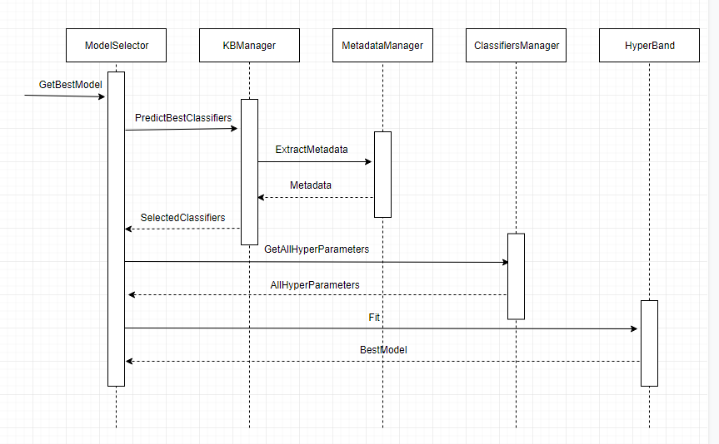
D-Smart Sequence Diagrams

Slide 17
Hyperband (1)
Based on Successive Halving, it consists of two loops:
the inner loop invokes SuccessiveHalving for fixed values of n and r
the outer loop iterates over different values of n and r
Hyperband Input:
R, the maximum amount of resource that can be allocated to a single configuration
η, an input that controls the proportion of configurations discarded in each round of SuccessiveHalving

Slide 18
Hyperband (2)
Bucket 1
(Successive Halving)
n = 81
Bucket 2
Successive Halving
n = 27
Bucket S max
Successive Halving
…..

Slide 19
Session One
Session Two
Session Three
All Hyperparameters Values
Hyperparameters:9
Hyperparameters:81
Hyperparameters:27
depth | Bins | Trees | impurity
5 | 32 | 10 | gini
5 | 32 | 10 | entropy
5 | 32 | 20 | gini
5 | 32 | 20 | entropy
5 | 32 | 30 | gini
5 | 32 | 30 | entropy
5 | 64 | 10 | gini
5 | 64 | 10 | entropy
5 | 64 | 20 | gini
5 | 64 | 20 | entropy
5 | 64 | 30 | gini
5 | 64 | 30 | entropy
5 | 128 | 10 | gini
5 | 128 | 10 | entropy
5 | 128 | 20 | gini
… | … | … | …
10 | 128 | 30 | gini
Hyperparameters:81
Data Percentage:1.23%
81 run
Best 30%
Hyperparameters:27
Data Percentage:3.7%
Randomly Get 81
Hyperparameters
value
27 run
Best 30%
Hyperparameters:9
Data Percentage:11.11%
9 run
Best 30%
Hyperparameters:3
Data Percentage:33.33%
3 run
Best Model

Slide 20
Session One
Session Two
Hyperparameters:81
Session Three
Hyperparameters:27
All Hyperparameters Values
Hyperparameters:9
Hyperparameters:81
Data :1.23%
depth | Bins | Trees | impurity
5 | 32 | 10 | gini
5 | 32 | 10 | entropy
5 | 32 | 20 | gini
5 | 32 | 20 | entropy
5 | 32 | 30 | gini
5 | 32 | 30 | entropy
5 | 64 | 10 | gini
5 | 64 | 10 | entropy
5 | 64 | 20 | gini
5 | 64 | 20 | entropy
5 | 64 | 30 | gini
5 | 64 | 30 | entropy
5 | 128 | 10 | gini
5 | 128 | 10 | entropy
5 | 128 | 20 | gini
… | … | … | …
10 | 128 | 30 | gini
Hyperparameters:27
Data :3.7%
81 run
27 run
Best 30%
Best 30%
Hyperparameters:27
Data :3.7%
Hyperparameters:9
Data :11.11%
27 run
9 run
Randomly Get 27
Hyperparameters
value
Best 30%
Best 30%
Hyperparameters:9
Data :11.11%
Hyperparameters:3
Data :33.33%
9 run
3 run
Best 30%
Hyperparameters:3
Data :33.33%
Hyperparameters:1
Data :100%
Best Model
3 run
Hyperparameters:1
Data :100%
Best Model

Slide 21
Session One
Session Two
Hyperparameters:81
Hyperparameters:27
Session Three
All Hyperparameters Values
Hyperparameters:9
Hyperparameters:81
Data :1.23%
Hyperparameters:27
Data :3.7%
depth | Bins | Trees | impurity
5 | 32 | 10 | gini
5 | 32 | 10 | entropy
5 | 32 | 20 | gini
5 | 32 | 20 | entropy
5 | 32 | 30 | gini
5 | 32 | 30 | entropy
5 | 64 | 10 | gini
5 | 64 | 10 | entropy
5 | 64 | 20 | gini
5 | 64 | 20 | entropy
5 | 64 | 30 | gini
5 | 64 | 30 | entropy
5 | 128 | 10 | gini
5 | 128 | 10 | entropy
5 | 128 | 20 | gini
… | … | … | …
10 | 128 | 30 | gini
Hyperparameters:9
Data :11.11%
81 run
27 run
9 run
Best 30%
Best 30%
Best 30%
Hyperparameters:27
Data :3.7%
Hyperparameters:9
Data :11.11%
Hyperparameters:3
Data :33.33%
27 run
9 run
Randomly Get 9
Hyperparameters
value
3 run
Best 30%
Best 30%
Hyperparameters:9
Data :11.11%
Hyperparameters:3
Data :33.33%
Hyperparameters:1
Data :100%
Best Model
9 run
3 run
Best 30%
Hyperparameters:1
Data :100%
Best Model
Hyperparameters:3
Data :33.33%
3 run
Hyperparameters:1
Data :100%
Best Model

Slide 22
Session One
Session Two
Session Three
Hyperparameters:81
Hyperparameters:27
Hyperparameters:9
All Hyperparameters Values
Hyperparameters:81
Data :1.23%
Hyperparameters:27
Data :3.7%
Hyperparameters:9
Data :11.11%
depth | Bins | Trees | impurity
5 | 32 | 10 | gini
5 | 32 | 10 | entropy
5 | 32 | 20 | gini
5 | 32 | 20 | entropy
5 | 32 | 30 | gini
5 | 32 | 30 | entropy
5 | 64 | 10 | gini
5 | 64 | 10 | entropy
5 | 64 | 20 | gini
5 | 64 | 20 | entropy
5 | 64 | 30 | gini
5 | 64 | 30 | entropy
5 | 128 | 10 | gini
5 | 128 | 10 | entropy
5 | 128 | 20 | gini
… | … | … | …
10 | 128 | 30 | gini
81 run
27 run
9 run
Best 30%
Best 30%
Best 30%
Hyperparameters:27
Data :3.7%
Hyperparameters:9
Data :11.11%
Hyperparameters:3
Data :33.33%
27 run
9 run
3 run
Best 30%
Best 30%
Hyperparameters:9
Data :11.11%
Hyperparameters:3
Data :33.33%
Hyperparameters:1
Data :100%
Best Model
9 run
3 run
Best 30%
Hyperparameters:1
Data :100%
Best Model
Hyperparameters:3
Data :33.33%
3 run
Hyperparameters:1
Data :100%
Best Model

Slide 23
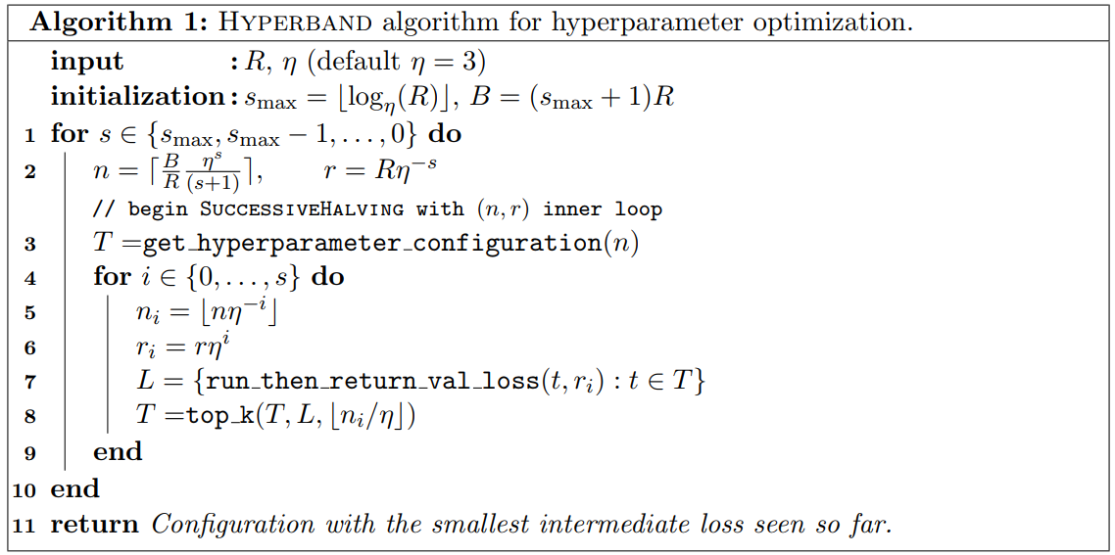
Hyperband (3)

Slide 24



Different Types of Resources
Time: training time could be used as a resource.
Data Set Subsampling: we treat the resource as the size of a random subset of the data set with R corresponding to the full data set size
Feature Subsampling: Down sampling the number of features

Slide 25
Hyperband Implementation for Spark
Fit
Hyperband
SuccessiveHalving
Learn

Slide 26
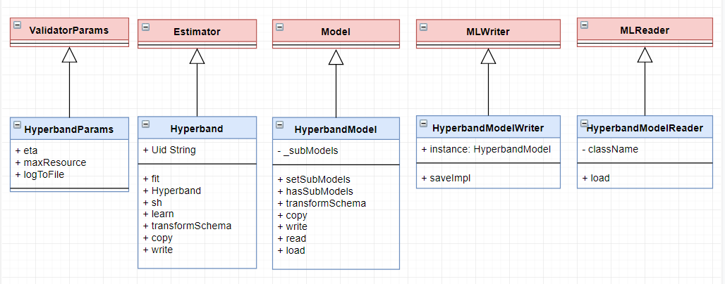
Hyperband Implementation for Spark

Slide 27
Example Hyperband Vs Grid Search

Slide 28
Hyperband vs Grid Search
Experiment on Random Forest Algorithm with Hyper-parameters
Number of Trees: (2, 5, 7, 10, 15, 20)
Maximum Depth:(2, 5, 7, 10, 15, 20)
Maximum Bins: (10, 50, 100, 200, 500, 1000 )
Impurity: ("gini", "entropy")
Multiple Datasets (from 50,000 up to 10,000,000) Instances
Two Methods:
Train - Validation Split
6 X 6 X 6 X 2 = 432 Configurations
75% to 25% ration between Training & Testing
Hyperband
Max Resources R = 100%
η = 5

Slide 29
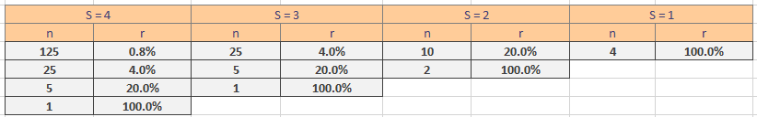
Hyperband vs Grid Search
η = 5
R = 100 %
n = 3 + 1

Slide 30
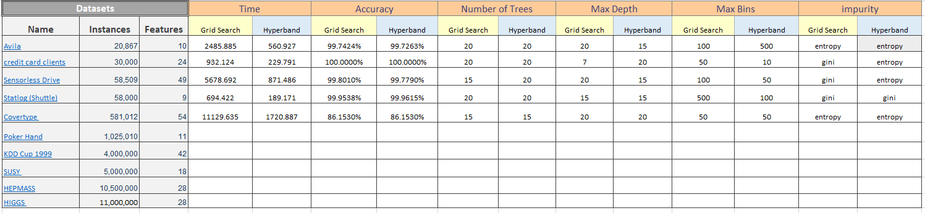
Hyperband vs Grid Search

Slide 31
Hyperband vs Grid Search

Slide 32

Proposal

Slide 33

Publishing in a Scopus – Indexed Journal

Slide 34
References
https://vimeo.com/274420720

Slide 35
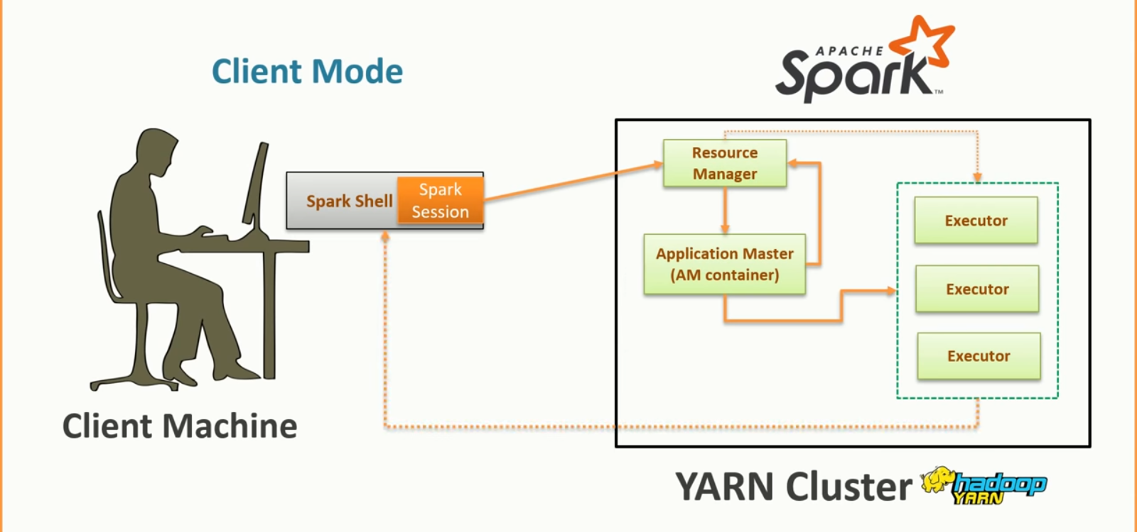
4
1
2
3
5
6

Slide 36
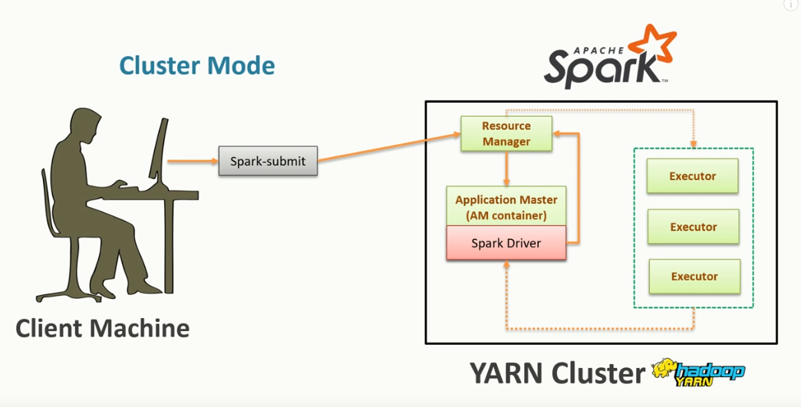

Slide 37
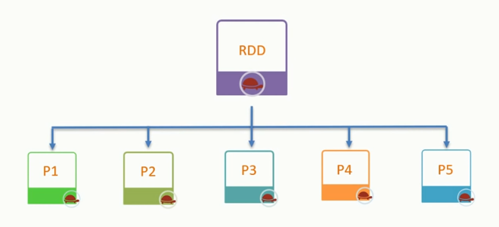

Slide 38
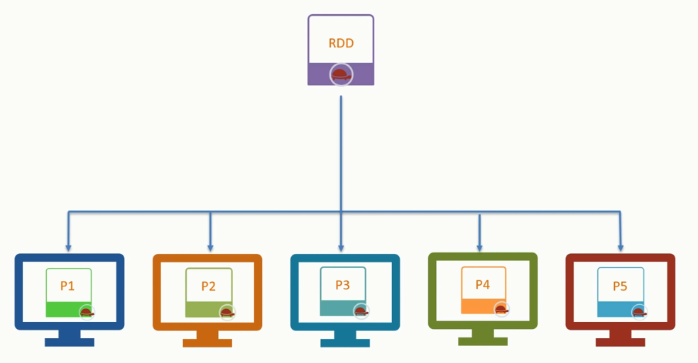

Slide 39
Tree-structured Parzen Estimator
the algorithm decides which set of parameters to try in the next iteration based on the distribution of the previous results
once it collected some initial results from Random Search, it divides the set of hyperparameters into two groups based on the score, typically \gamma \in [20\%, 25\%] of best hyperparameter combinations go to a good group.
Reference: http://dkopczyk.quantee.co.uk/hyperparameter-optimization/

Slide 40
Calculate skewness and kurtosis
https://www.itl.nist.gov/div898/handbook/eda/section3/eda35b.htm

Slide 41
Logistic regression
Decision tree
Random forest
Gradient-boosted
Multilayer perceptron
Linear Support Vector Machine
Naive Bayes

Slide 42
Logistic regression
can be used to predict a multiclass outcome by using multinomial logistic regression [.setFamily("multinomial")], we can leave it and leave it unset and Spark will infer the correct variant.

Slide 43
Datasets
pump_sensor_data
https://www.kaggle.com/nphantawee/pump-sensor-data
Size: 118 MB
Instances: 220,000 X 55
WESAD
https://archive.ics.uci.edu/ml/datasets/WESAD+%28Wearable+Stress+and+Affect+Detection%29#
Size: 1.2 GB
Instances: 63,000,000

